Slide 1
II⁷ & VII⁷ Chords
MUS 213

Slide 2
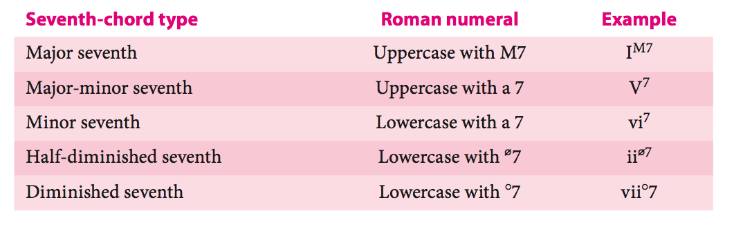
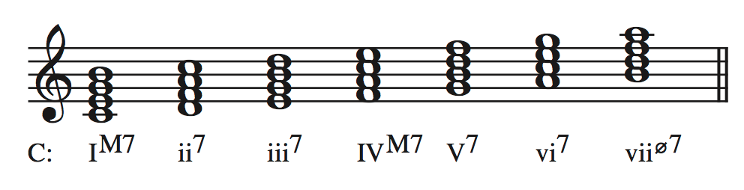
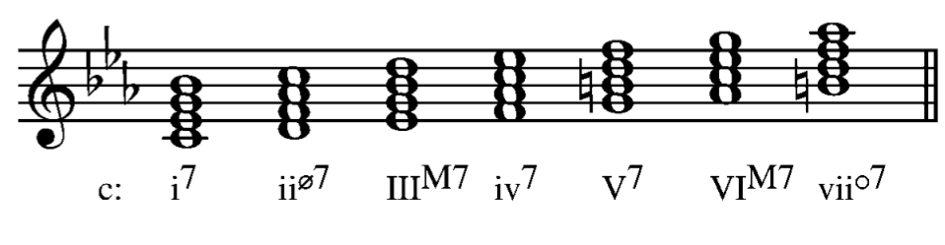
Diatonic Seventh Chords
Any diatonic triad may appear with a 7th added.
Quick Review:
MAJOR
minor
Notes:
We have already seen a bunch of 7th chords, now we will look closley at how composers use them in tonal music. We will look at common and proper ways to handle the dissonance in the seveth chords.

Slide 3
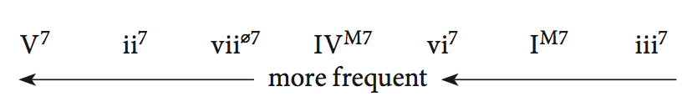
Diatonic Seventh Chords
The various diatonic seventh chords do not occur with equal frequency.
Most seventh chords used are dominant sevenths
V⁷ chords
Secondary V⁷ chords (to be discussed next semester)
V⁷ chords from another key
In major, the most common diatonic seventh chord other than the V⁷ is the ii⁷
Approximate ranking by frequency of diatonic seventh chords in the major mode
A diagram for the minor mode would be somewhat similar to the above, but is difficult to produce due to the larger number of possible seventh chords. Let’s adapt the above diagram to minor….

Slide 4
Voice-leading & 7th chords
We handle all seventh chords similarly to how we handle the V⁷.
The 7th of the chord almost always resolves down by step.
The 7th of the chord may be approached in various ways.
Especially common is the suspension figure, although the passing tone figure also works well.
Neighbor and appoggiatura figures are less common.
Incomplete chords must contain at least the root and the 7th.
Doubled tones should not be the chord 7th or the leading tone.

Slide 5
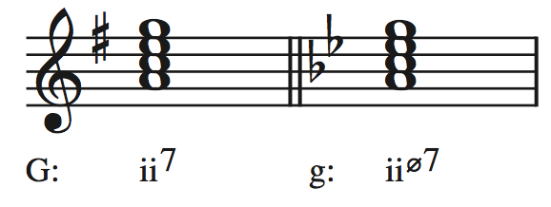
ii⁷ & ii^{ø7}
The most common of non-dominant diatonic seventh chords are supertonic sevenths.
In major, minor seventh, ii⁷
In minor, half-diminished seventh, ii^{ø7}
Like the supertonic triad, the supertonic seventh typically moves to V.
V could be delayed by a cadential I6/4 chord
V could also be represented by a viiº⁶ chord

Slide 6
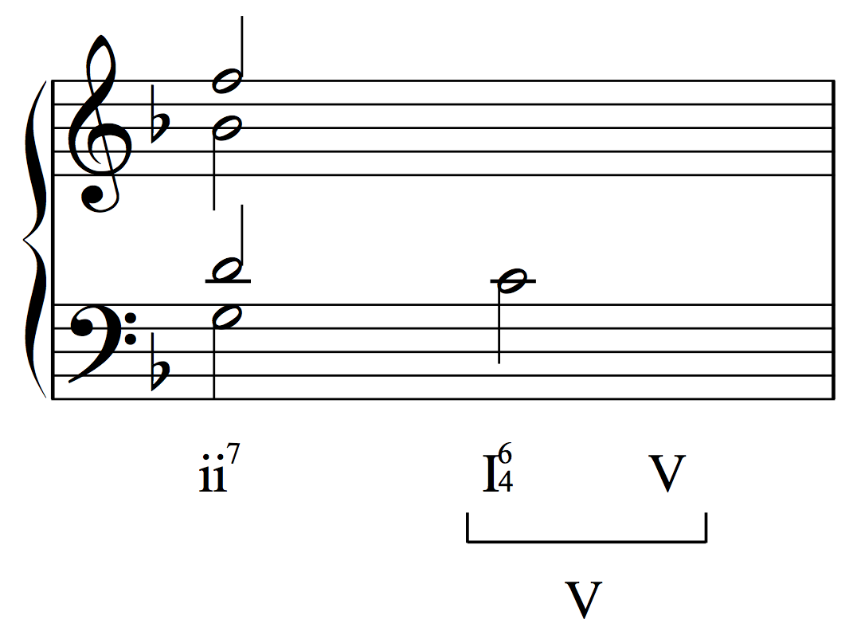

Slide 7
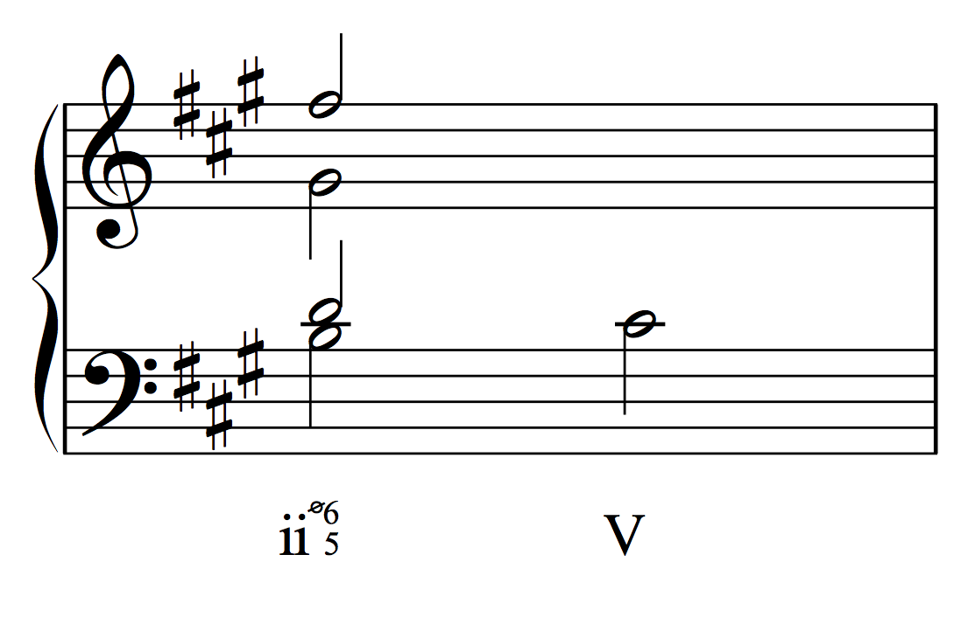

Slide 8
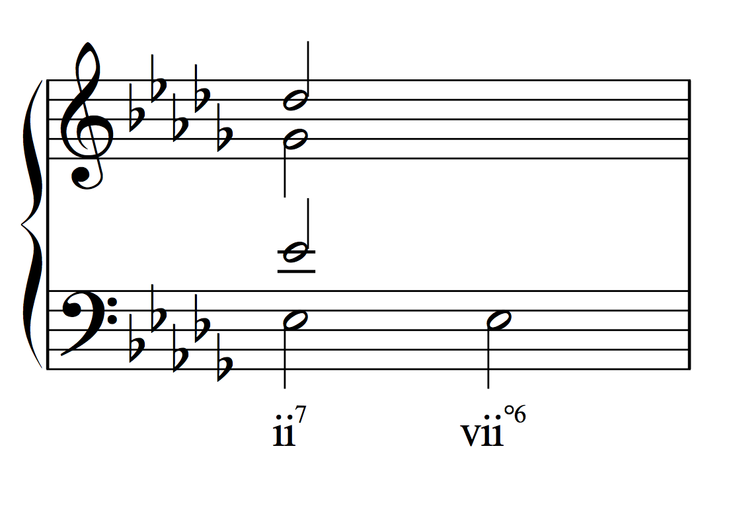

Slide 9
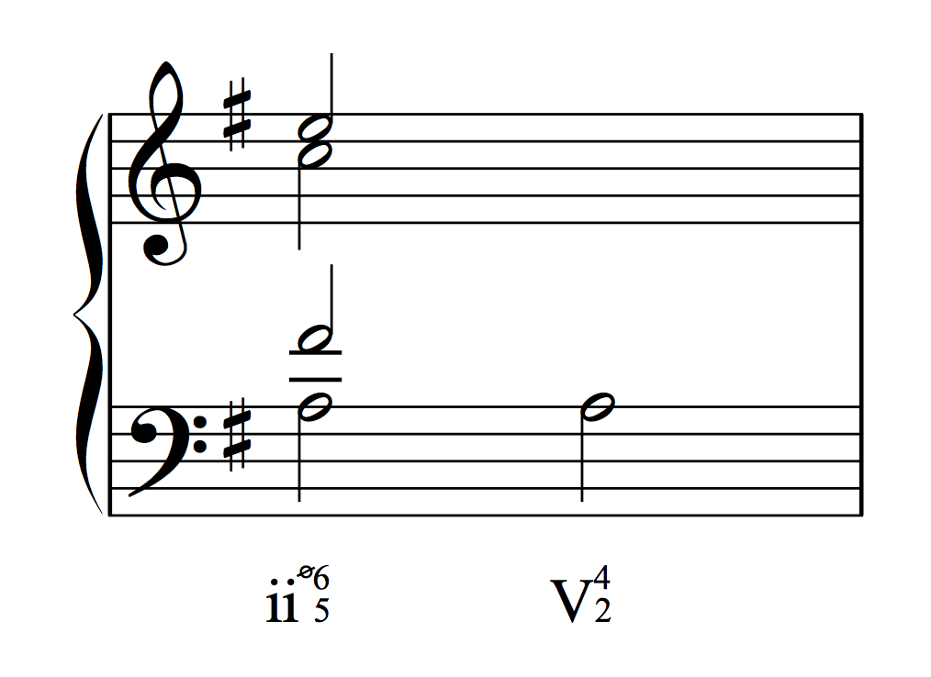

Slide 10
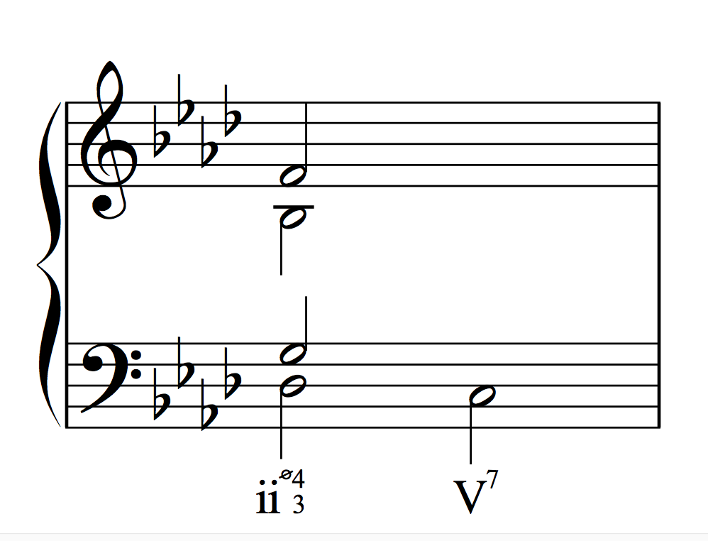

Slide 11
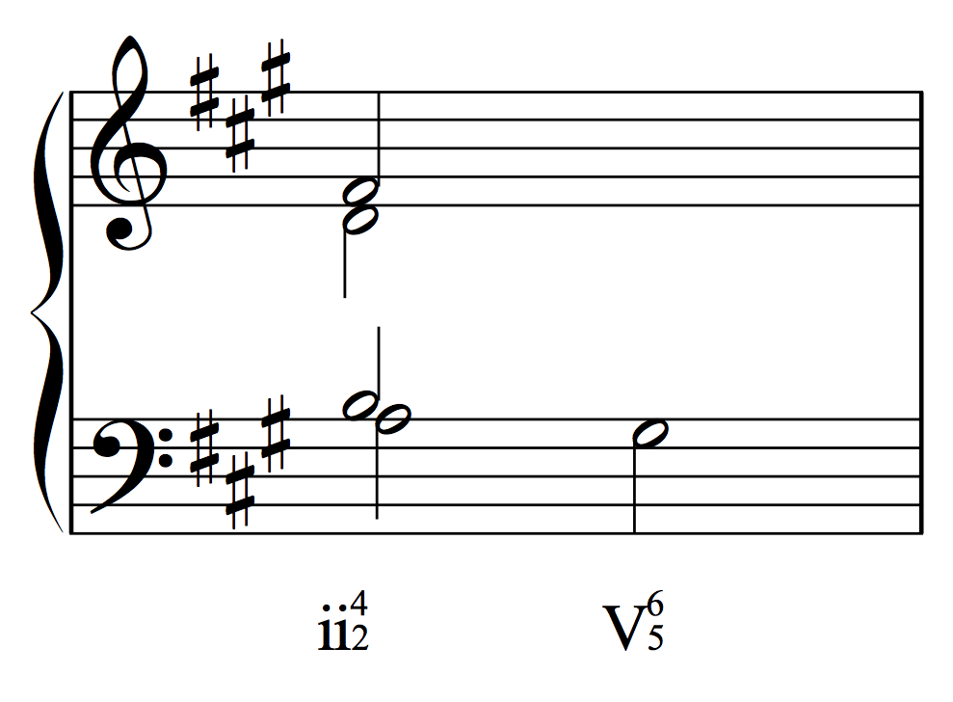

Slide 12

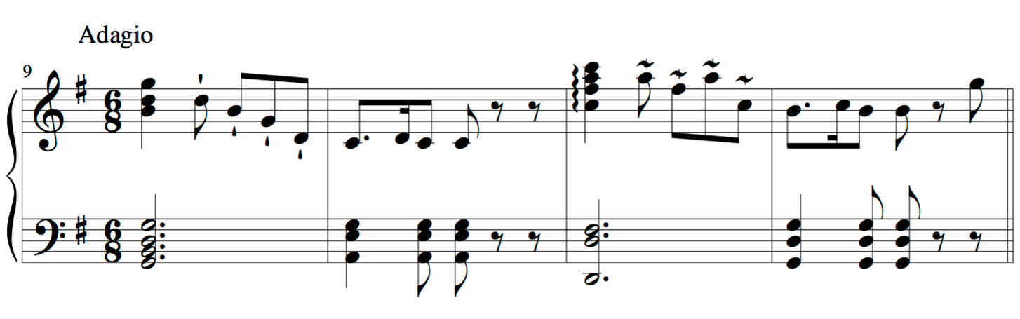
Haydn, Piano Sonata in e minor, Hob. XVI: 47, mvt. 1, mm. 9-12

Slide 13
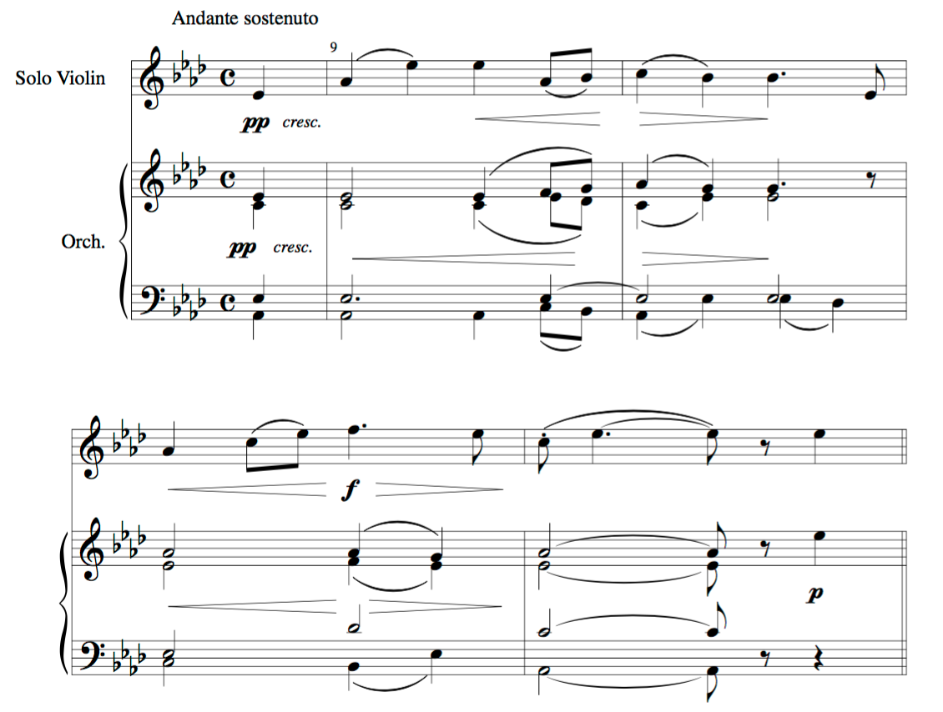
Bruch, Scottish Fantasy, op. 46, mvt. 3, mm. 9-12

Slide 14
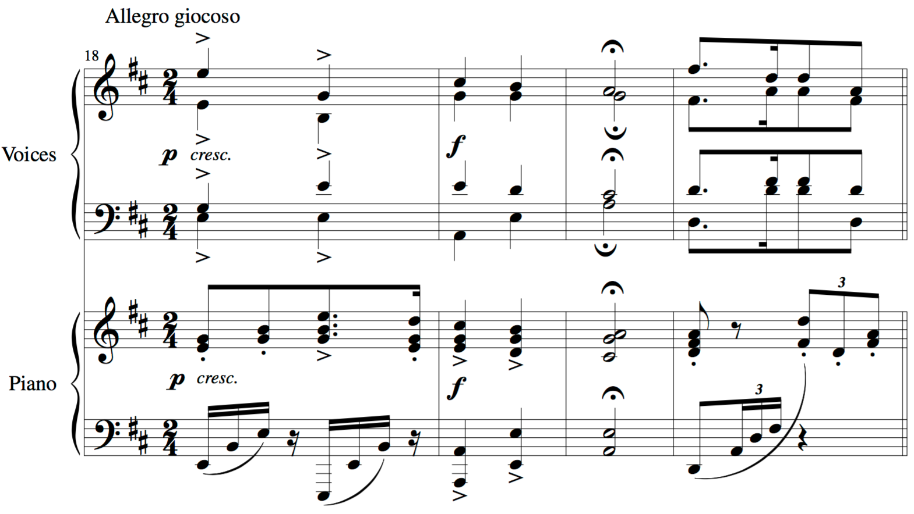
Brahms, Zigeunerlieder, op. 103 no. 5 (“Brauner Bursche”), mm. 18-21

Slide 15
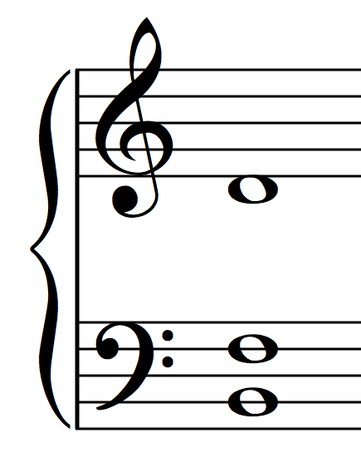
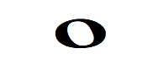
vii^{ø7} in Major
The diatonic seventh chord on the leading tone in major is half-diminished.
Like the viiº triad, the vii^{ø7} has a dominant function.
Typically resolves to the tonic
Can also resolve to V⁷, by moving a single note (^6, the seventh of vii

Slide 16
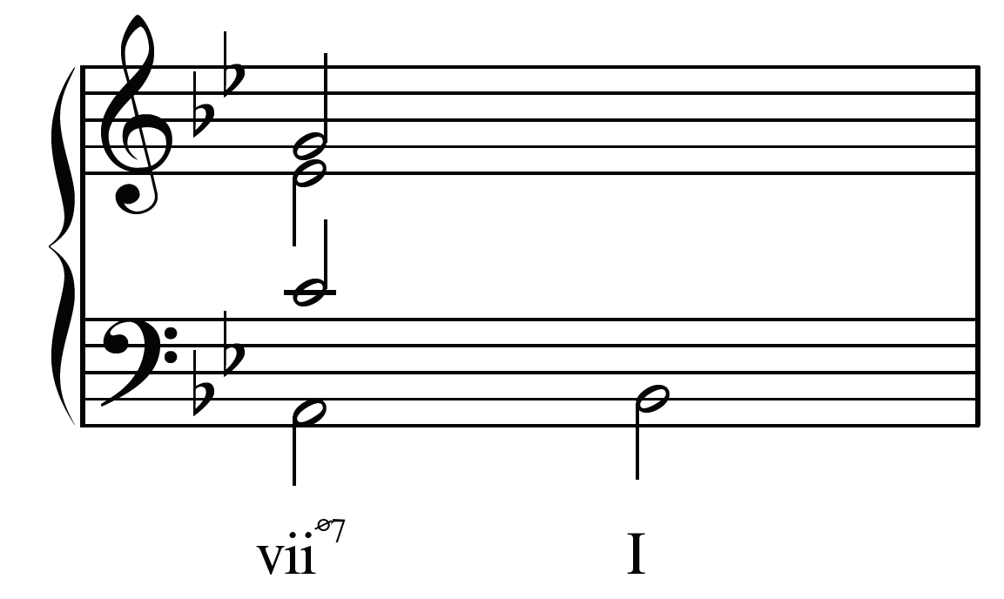

Slide 17
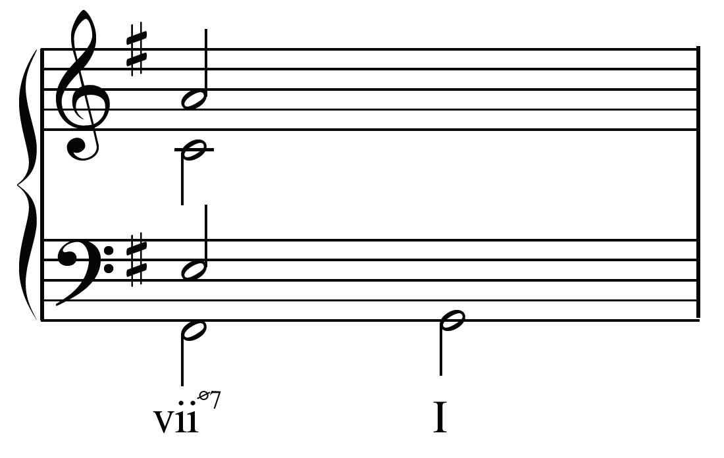

Slide 18
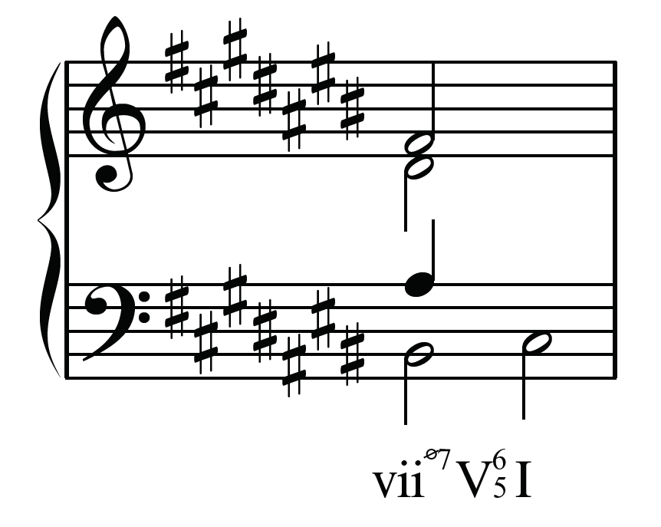

Slide 19
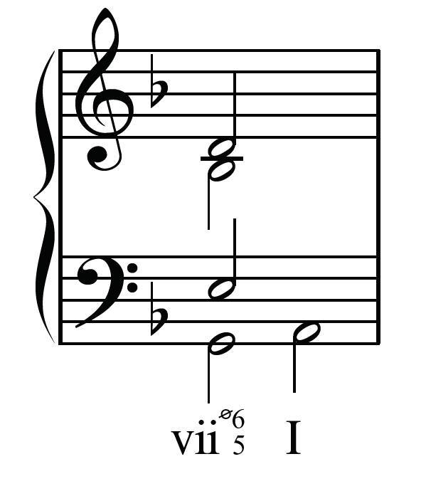

Slide 20
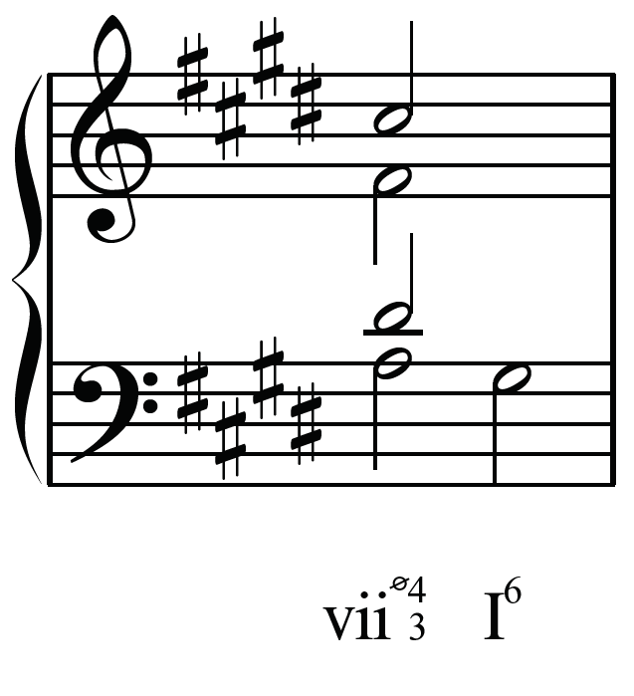

Slide 21
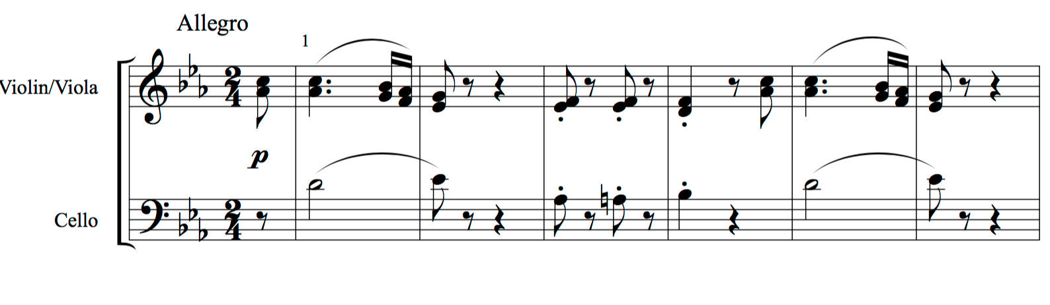
Beethoven, String Trio in E-flat Major, op. 3 no. 1, Finale, mm. 1-24

Slide 22
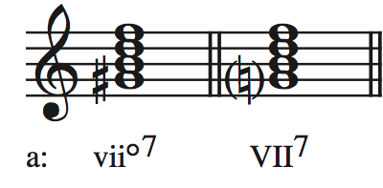
vii^{o7} in minor
The diatonic seventh chord on the leading tone in minor is (fully) diminished.
The diatonic seventh chord on the subtonic (VII⁷) is generally used in:
Sequences
We’ll get to that next week
Secondary Dominants (V⁷ of III)
We’ll get to that next semester

Slide 23
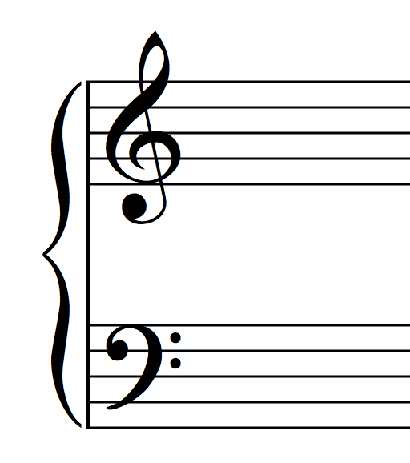
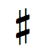
vii^{o7} in minor
The vii^{o7} in minor also has a dominant function.
It is comprised of two tritones.
How do we resolve the tritone in the V⁷ chord when:
it is a º5
Resolve inward to a 3rd
It is a +4
Resolve outward to a 6th
Notice the this results in doubling the third of the tonic triad
However, it is acceptable to resolve ^2 to ^1
this may result in unequal 5ths

Slide 24
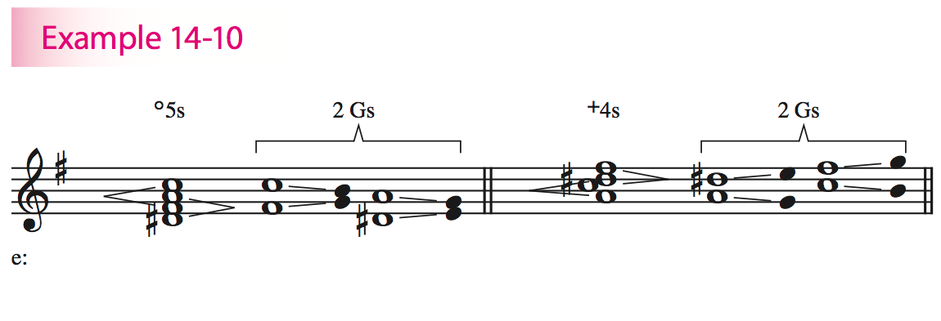
vii^{o7} in minor

Slide 25
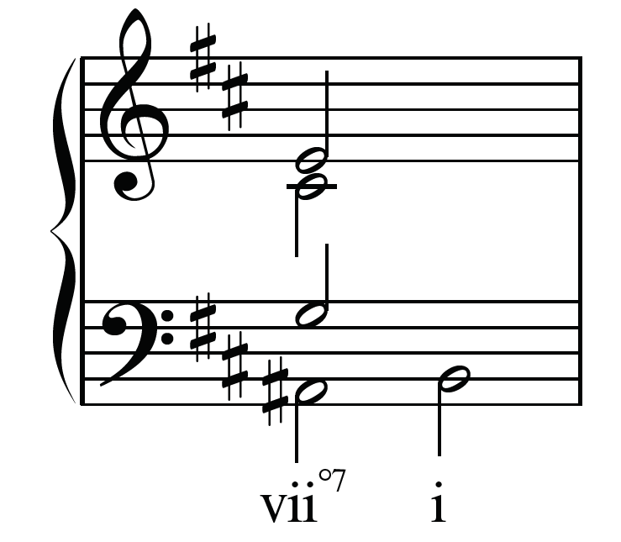

Slide 26
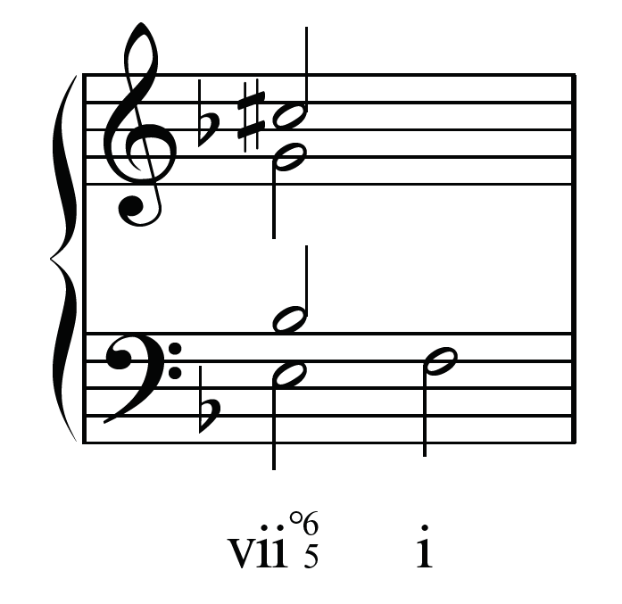

Slide 27
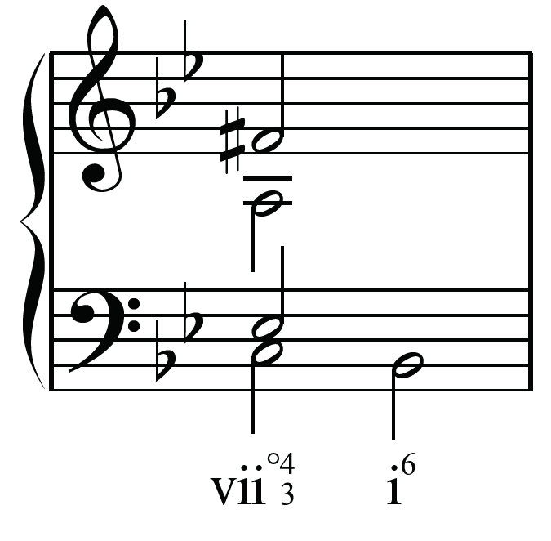

Slide 28
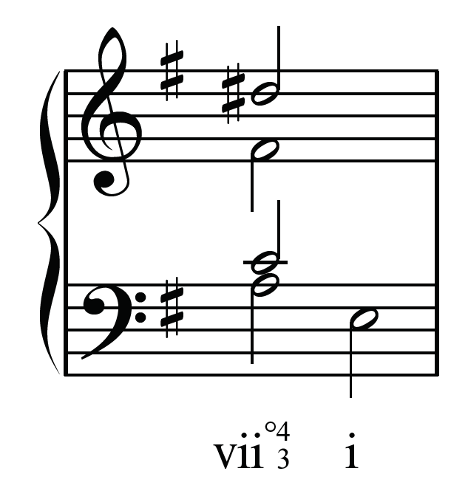

Slide 29
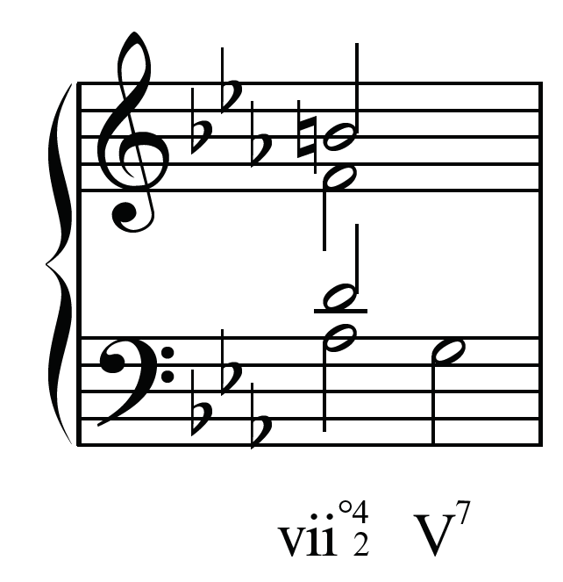

Slide 30
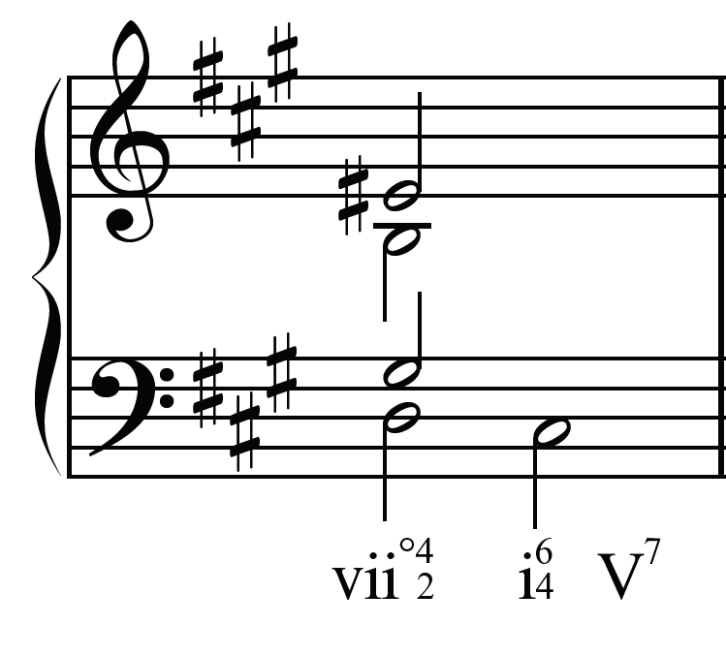

Slide 31
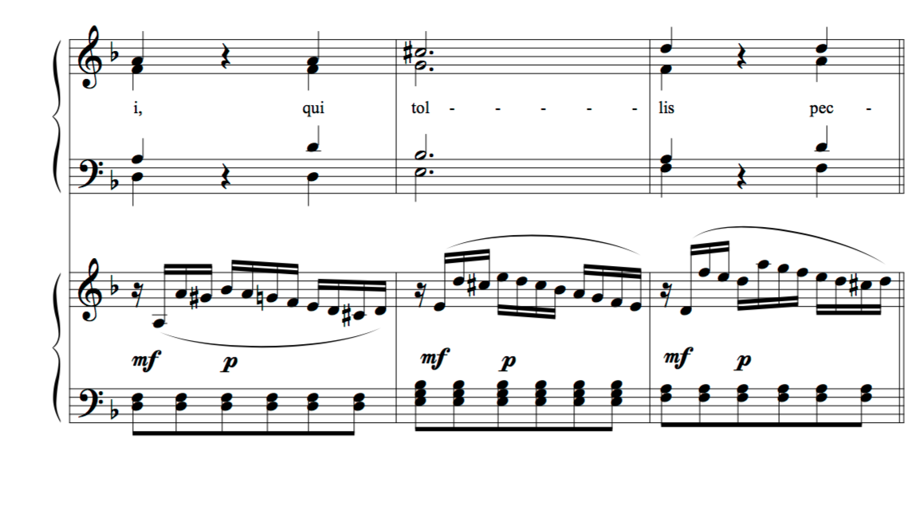
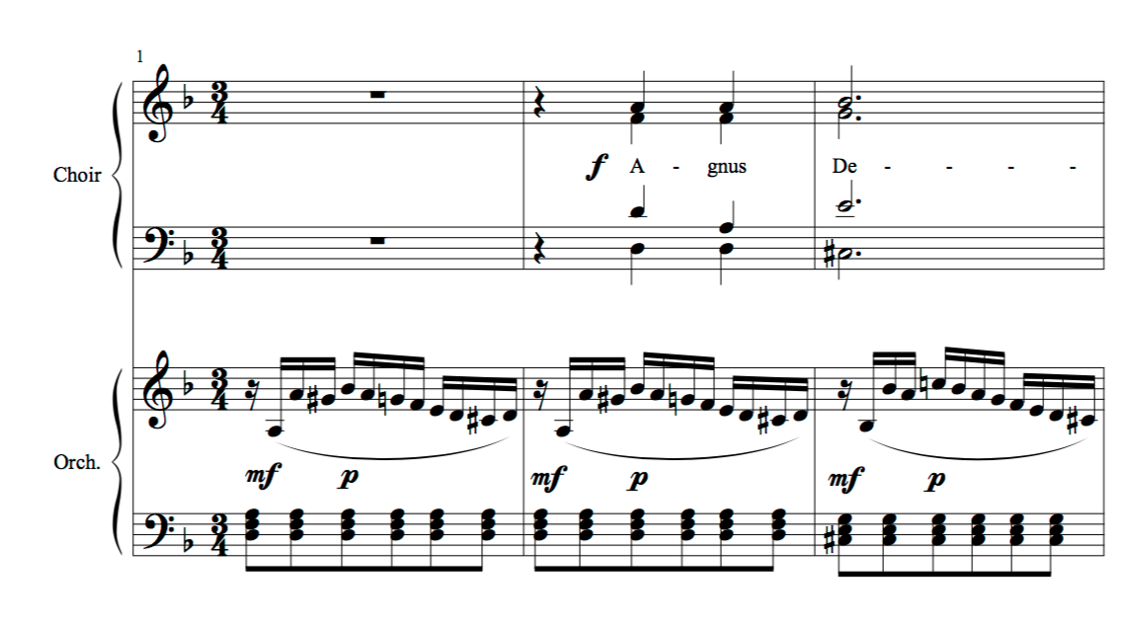
Mozart, Requiem, K. 626, Agnus Dei, mm. 1-6

